Slide 1
Testing
Test plan, test environments, test result

Slide 2
Test Plan
E-COMMERCE
INTERNET SHOPPING
01
Functional testing
Unit testing
Integration testing
02
Non-functional testing
Usability testing
Performance testing
Security testing
03
Testing Strategy
System testing

Slide 3
Functional testing
Unit testing
01
Validate that each unit of the software code performs as expected. Unit testing is a White Box testing technique that is usually performed by the developer
Integration testing
02
Purpose of this level of testing is to expose defects in the interaction between these software modules when they are integrated

Slide 4
Non-functional testing
Usability testing
01
Determine how user-friendly, easy-to-use and intuitive the user interface is. The usability test is performed by tester and the end user of the website
Performance testing
02
Identify the performance bottlenecks in speed, response time, stability, reliability, scalability and resource usage of the application under testing workload
Security testing
03
Verify sensitive information such as passwords, e-mails, bank accounts, etc. of the user are encrypted. Prevent unauthorized action

Slide 5
System testing
The main testing strategy for our software
Our software is compiled as a whole and then tested as a whole at dangcompany.herokuapp.com
Most testing operation is performed on this website to check the functionality, security, portability, amongst others

Slide 6
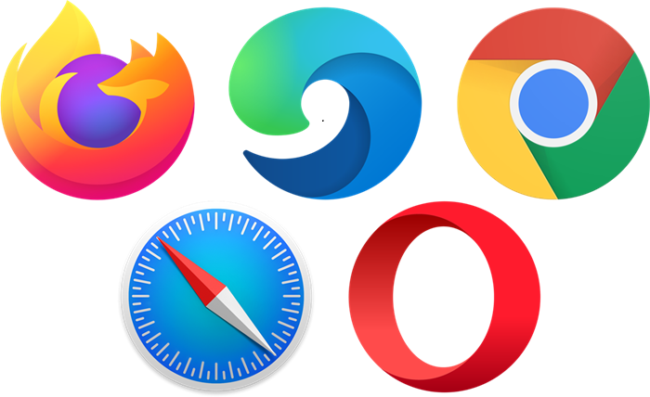
Test enviroments
Browser
- Chrome 45+
- Firefox 38+
- Edge 12+
- Safari 9+
- Opera 30+
Hardware
Person computers running Windows 10
Smart phones running iOS, Android
Internet connection
Notes:
More browser: Android browser, IE, … but cannot be test cause lack of resources and time

Slide 7
Test result - Functional
Test case
Test Pass
Test Fail
Fixed
222
165
57
32
Notes:
Most failed cases are System not checking user input special characters. Few critical failure are that the webpage or function is not implement

Slide 8
Test result - Performance
Notes:
Cause the database is located away from server, every operation require data from database can take a long time

